Slide 1
Teradata Bacis
Lesson 07: Teradata Popular OLAP Examples

Slide 2
Module Object
To be familiar with popular OLAP functions.
To be familiar with the PARTITION By concept.
To be familiar with RANK() . ROW_NUMBER(), QULIFY functions.

Slide 3
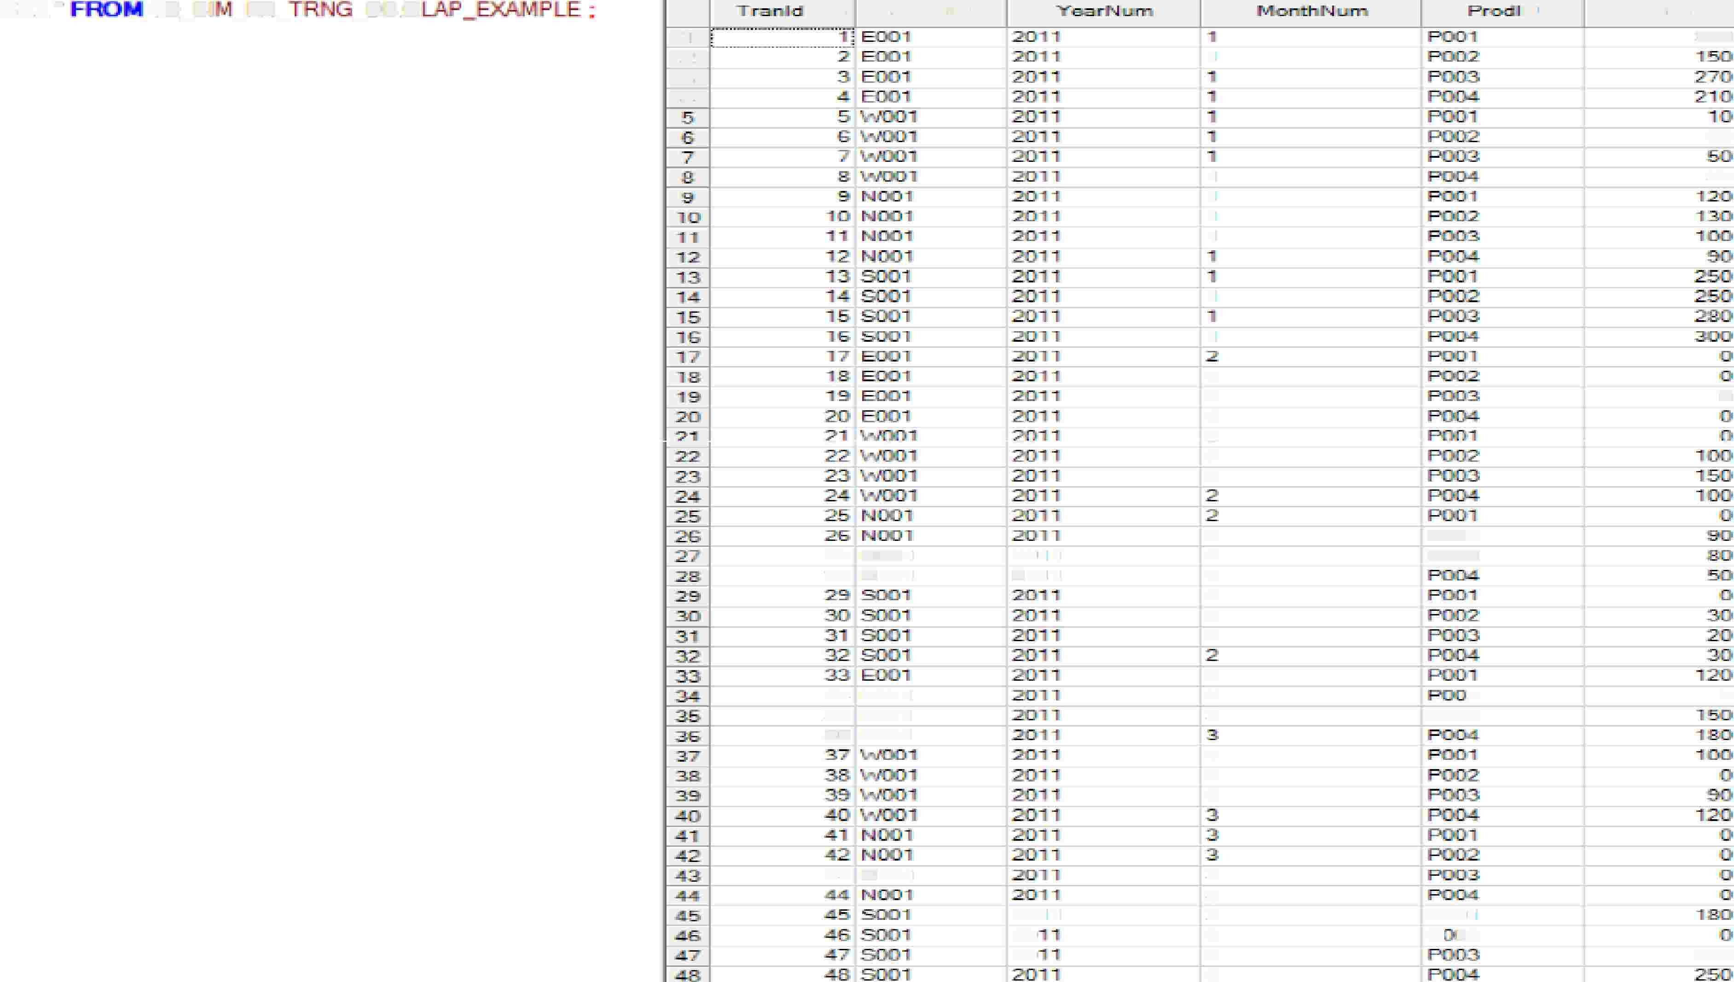
Example Table “OLAP_EXAMPLE”
SEl..'"'
. TID_B.I
-^{FR_}
_DB.O
...ci..
Sto:JielD
[J
Sa.lea
11
2
.3
.d
1
330
25
1
1
1
1
so
1
1
.2
2
2
7
2
2
0
27
1)111001
2011
.2{)111
2
2
2
2
2
2
ROIJ2
ROOi3
.28 N001
34! BIJIOl
35 EOBl
36 E001
3
3
3
2
POl)\3
0
3
3
3
43
1)111001
3
3
3
3
3
3
2(l11
2:0
20
POCilr'I
H·o2
22D

Slide 4

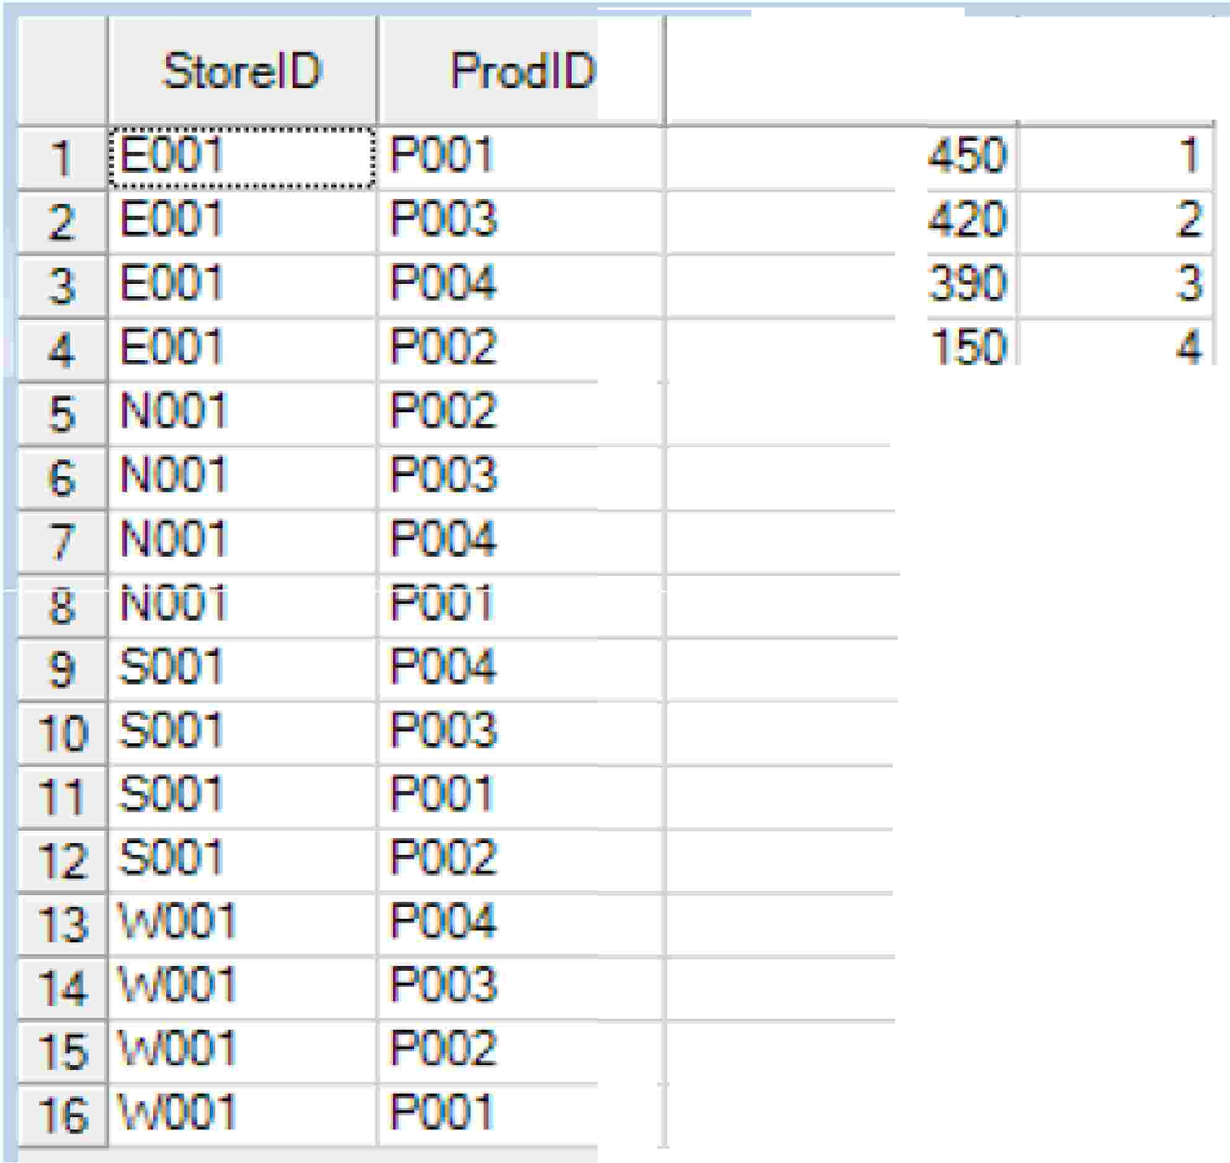




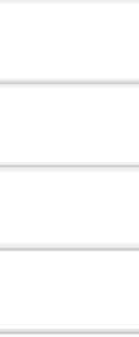
Usage of PARTITION by to derive RANK
to
i . d 't - e RANIK
'for each p 01,_, uct; based
on the
· 1i th, n
sum sa e5 value �desc)
eac - S'tora •1 I
E5)S5 LES.
STORBID ORDER
PUE
SS
LES D:
·
- AS R .
•
I

Slide 5
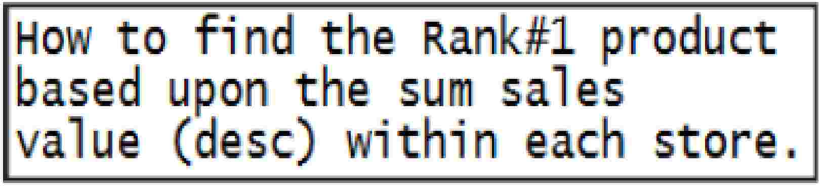
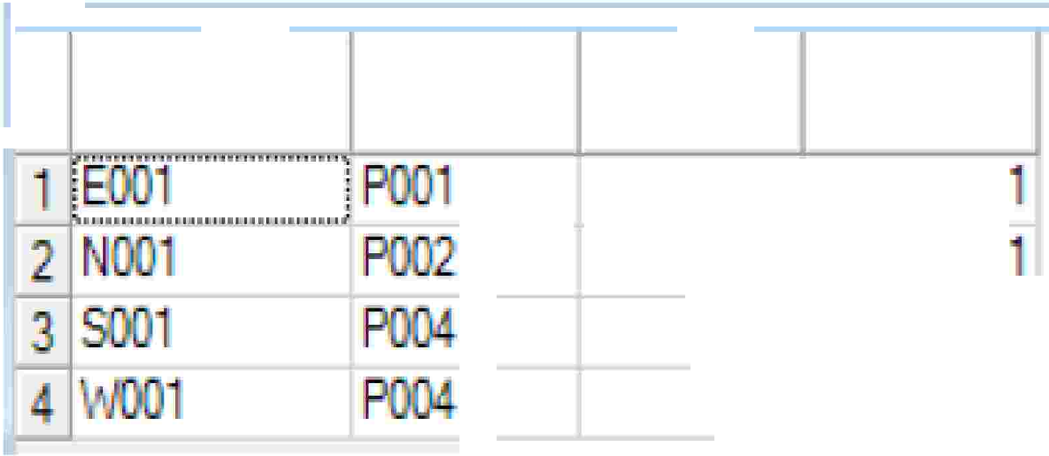



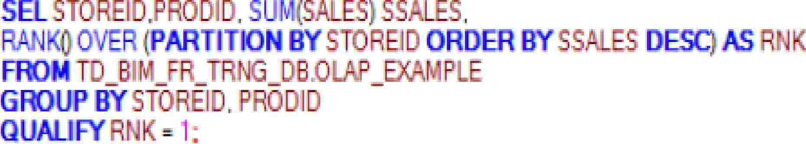
Usage of RANK & QUALIFY
Pr
. I

Slide 6
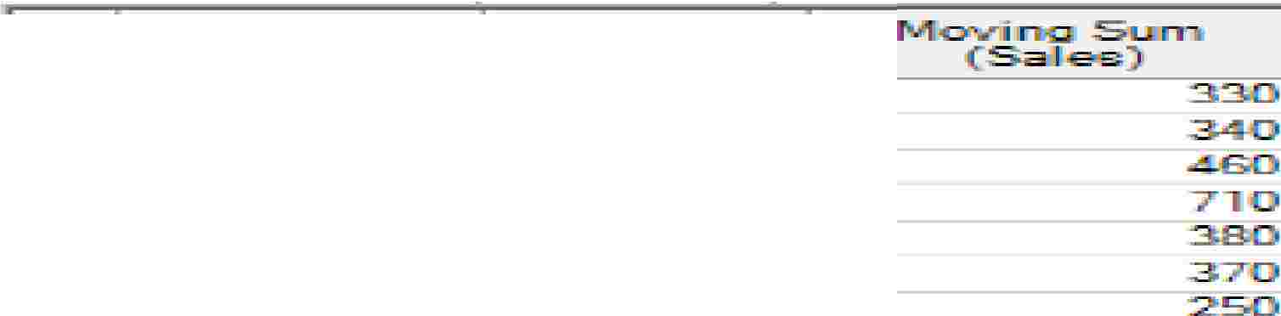


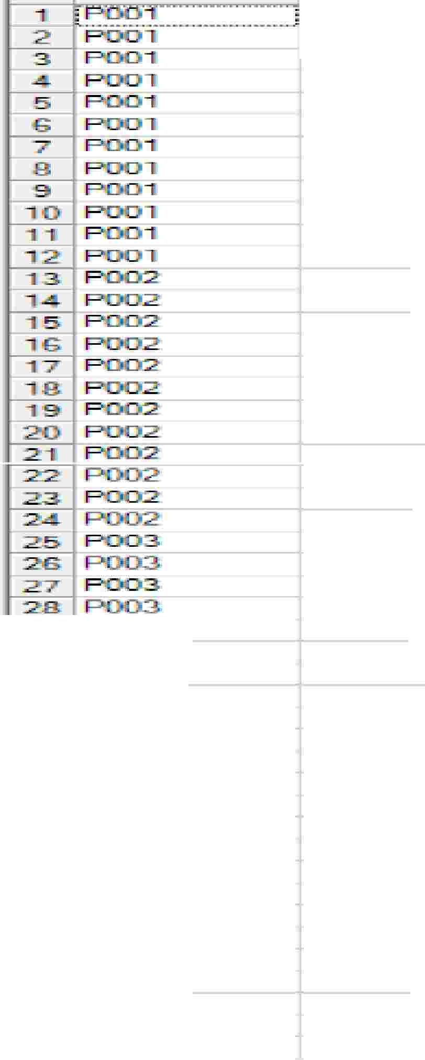
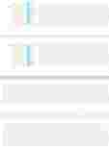

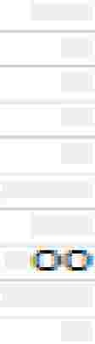
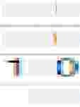


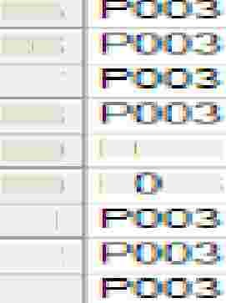

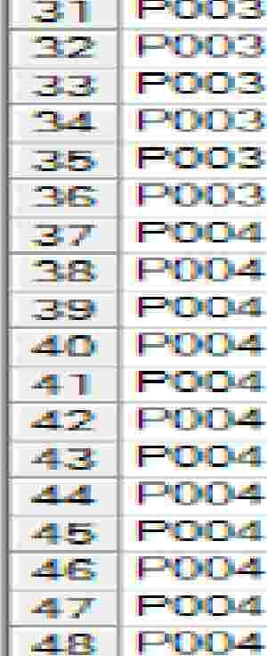





Usage of ROWS BETWEEN (PRECEDING-FOLLOWINGCURRENT ROW)
Ho to fi 1d the mo¥, g sum
for eac product i eluding
current ro and 3 ro s prideding.
R.-..:::x::IID
0
I!]!
·151rni
175
3i{),5
.!555
....
0
� 1 Poonm_ � !=.!=:_
sur (S. ES) OVER ( PAR I
OWS BETWEEN 3 P ECE I G
IFRO TiD _13 I 1.11_FR_TA G_D B .0 LA
3!(]11
0
0
0
0
270
5'0
.22:liJII
:2:2:li]i
2
30
ID
.25
26
27
28
29
3C1
3,
32
33
....
Pl:303.
p 03
280
0
....
90
P004
p
p[]!(Ja4.
P.:
p
p p p
p()i(W.
P.: p: p
22iO
-.1:0
.80
"90

Slide 7


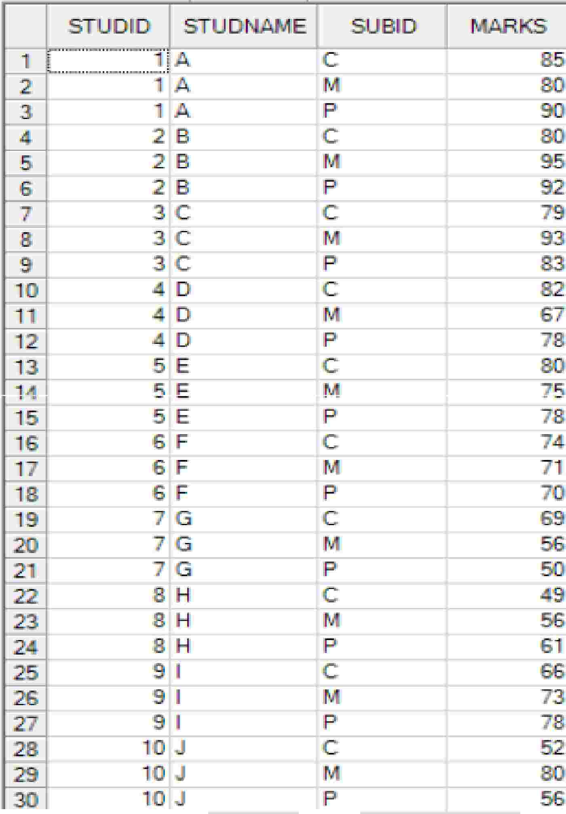
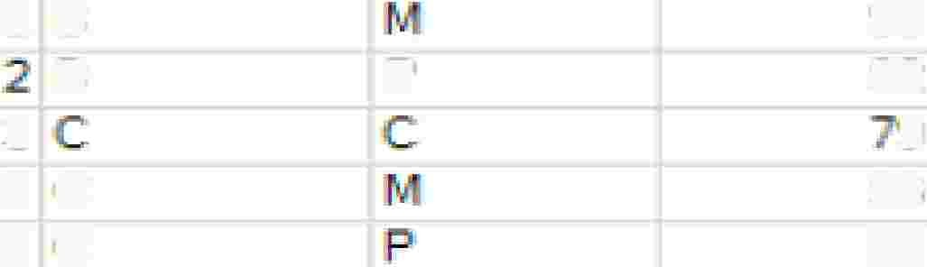
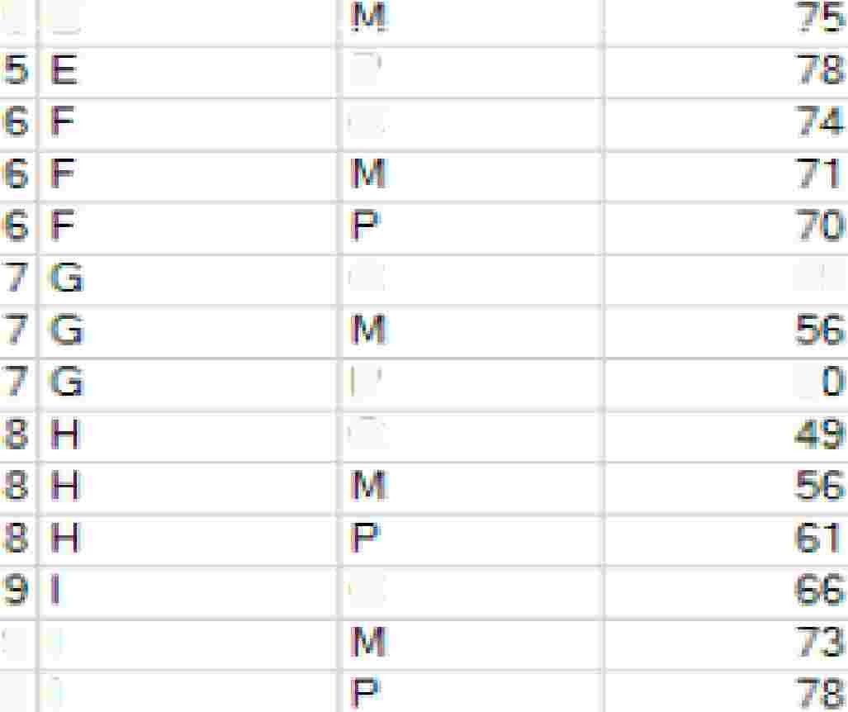
Example Table “OLAP_EXAMPLE_CLASS”
s
2
B
8
.95
'92
.91
'93
S3
3
3
3
IP
c
c
5
E
p
c
c
p
c
69
5
c
9
9
I
I

Slide 8
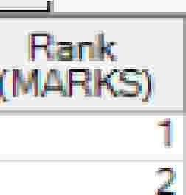
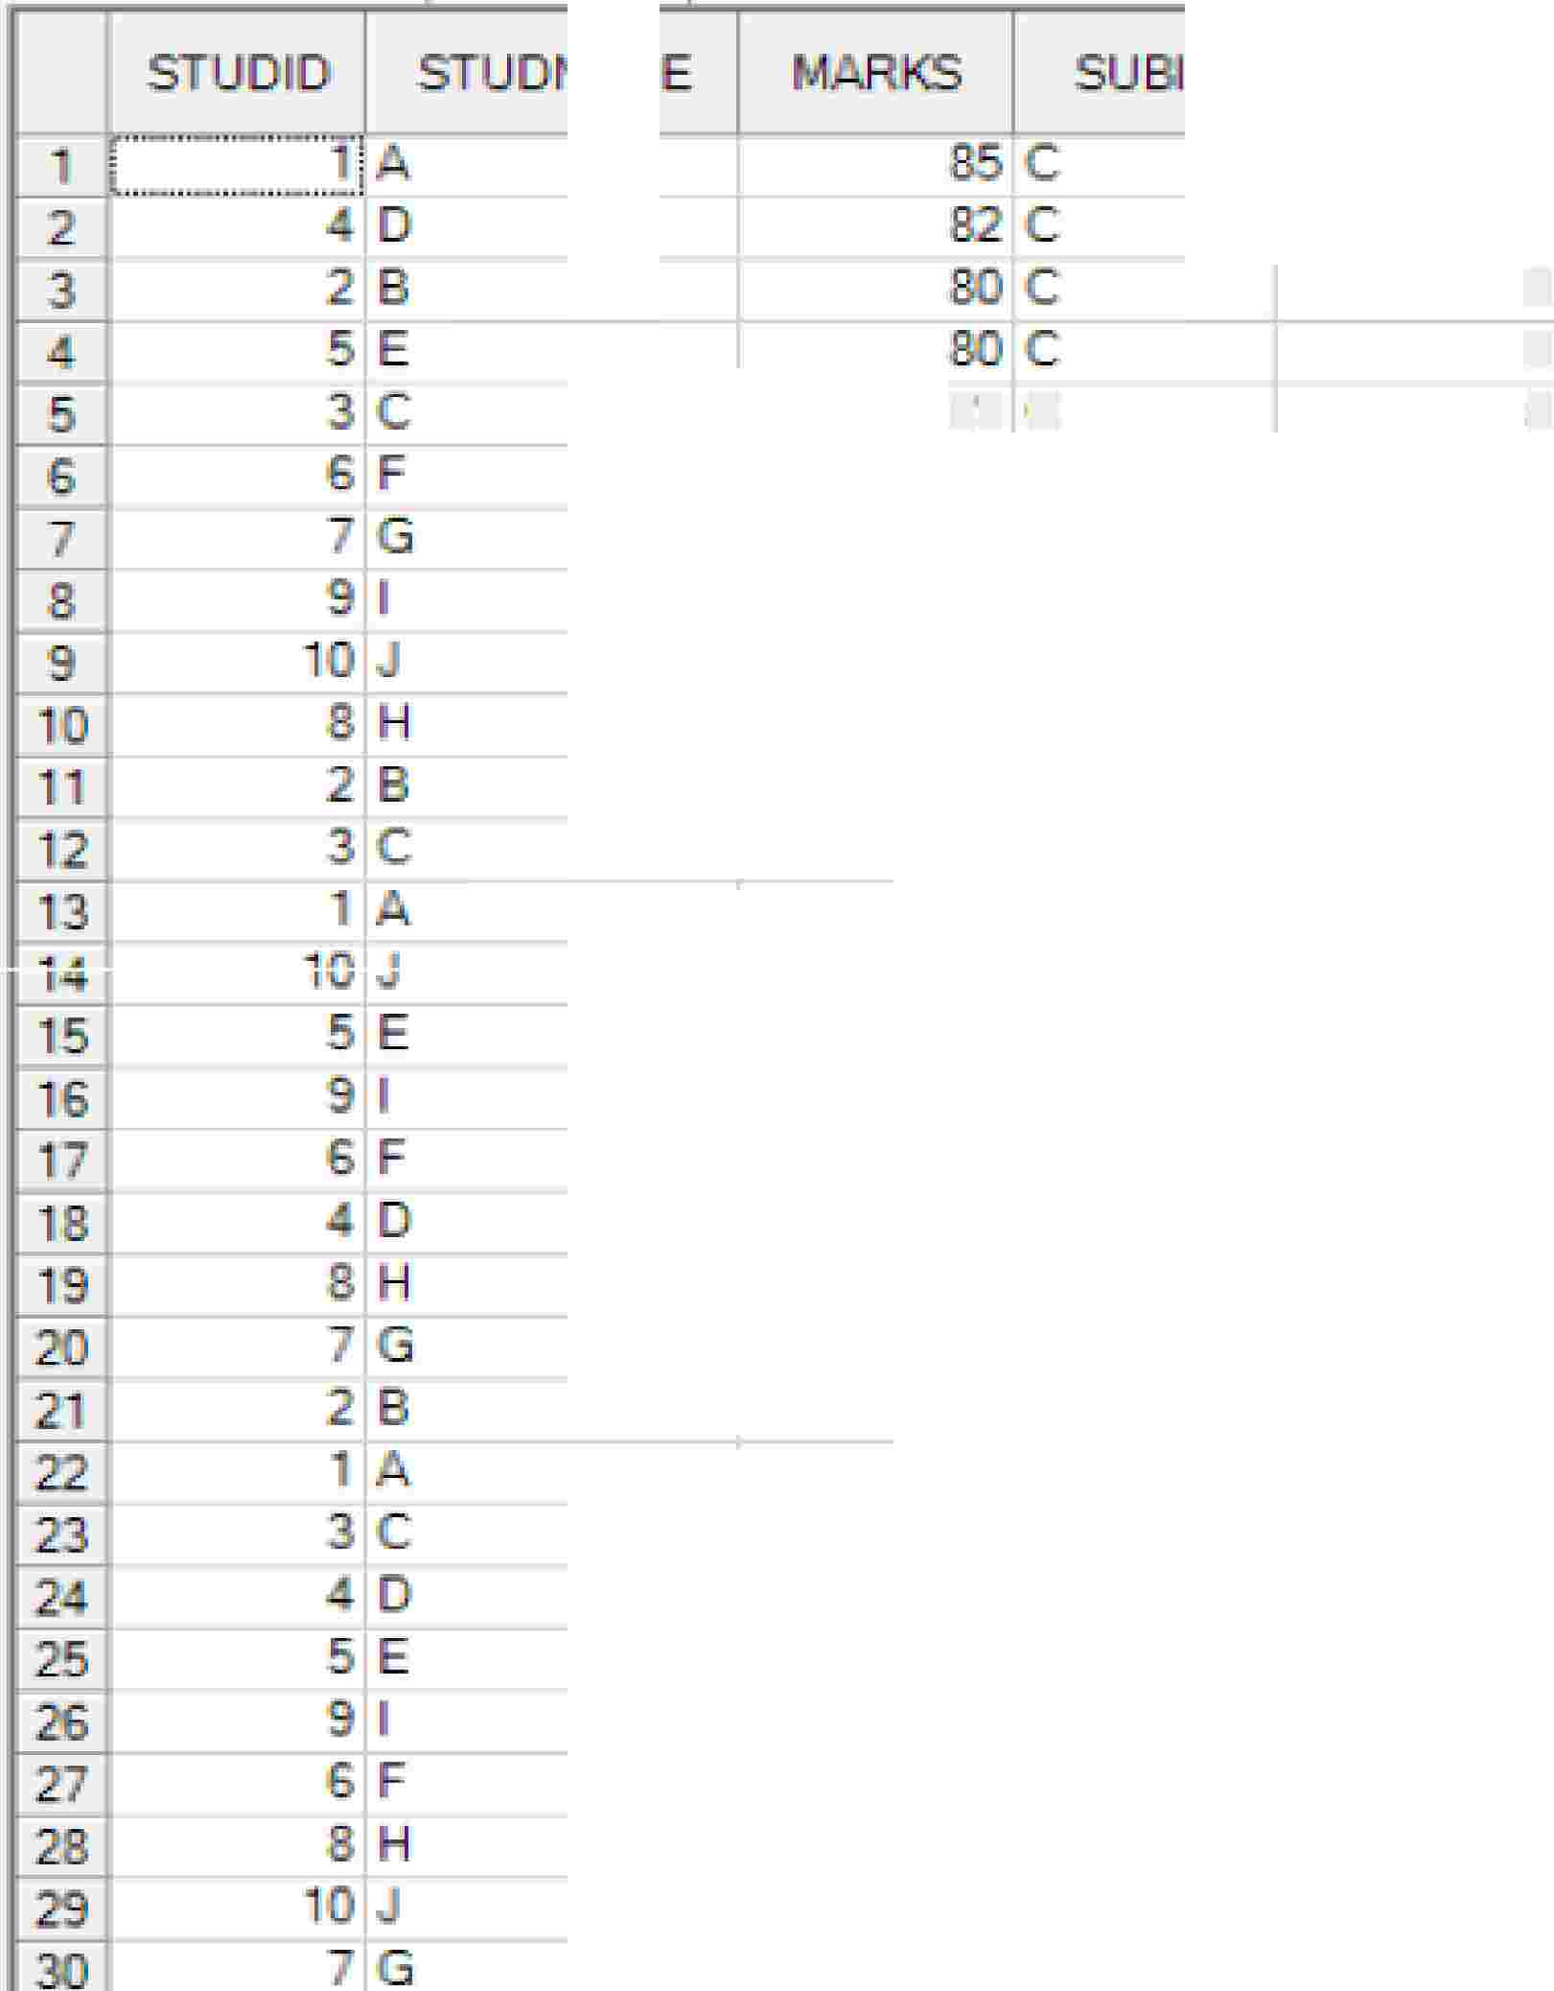

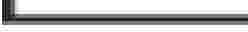
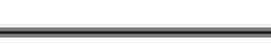








Usage of RANK & PARTITION BY
Ho
to f'i nd t.nfi RA-· K 01-f
each s�ud� � on eac
3
3
5
sub-ect �ased on the,•
obt.a'i ed nar-ks..,
79 C
7
C
1
'9
2
'9
.9
.....
p
11

Slide 9
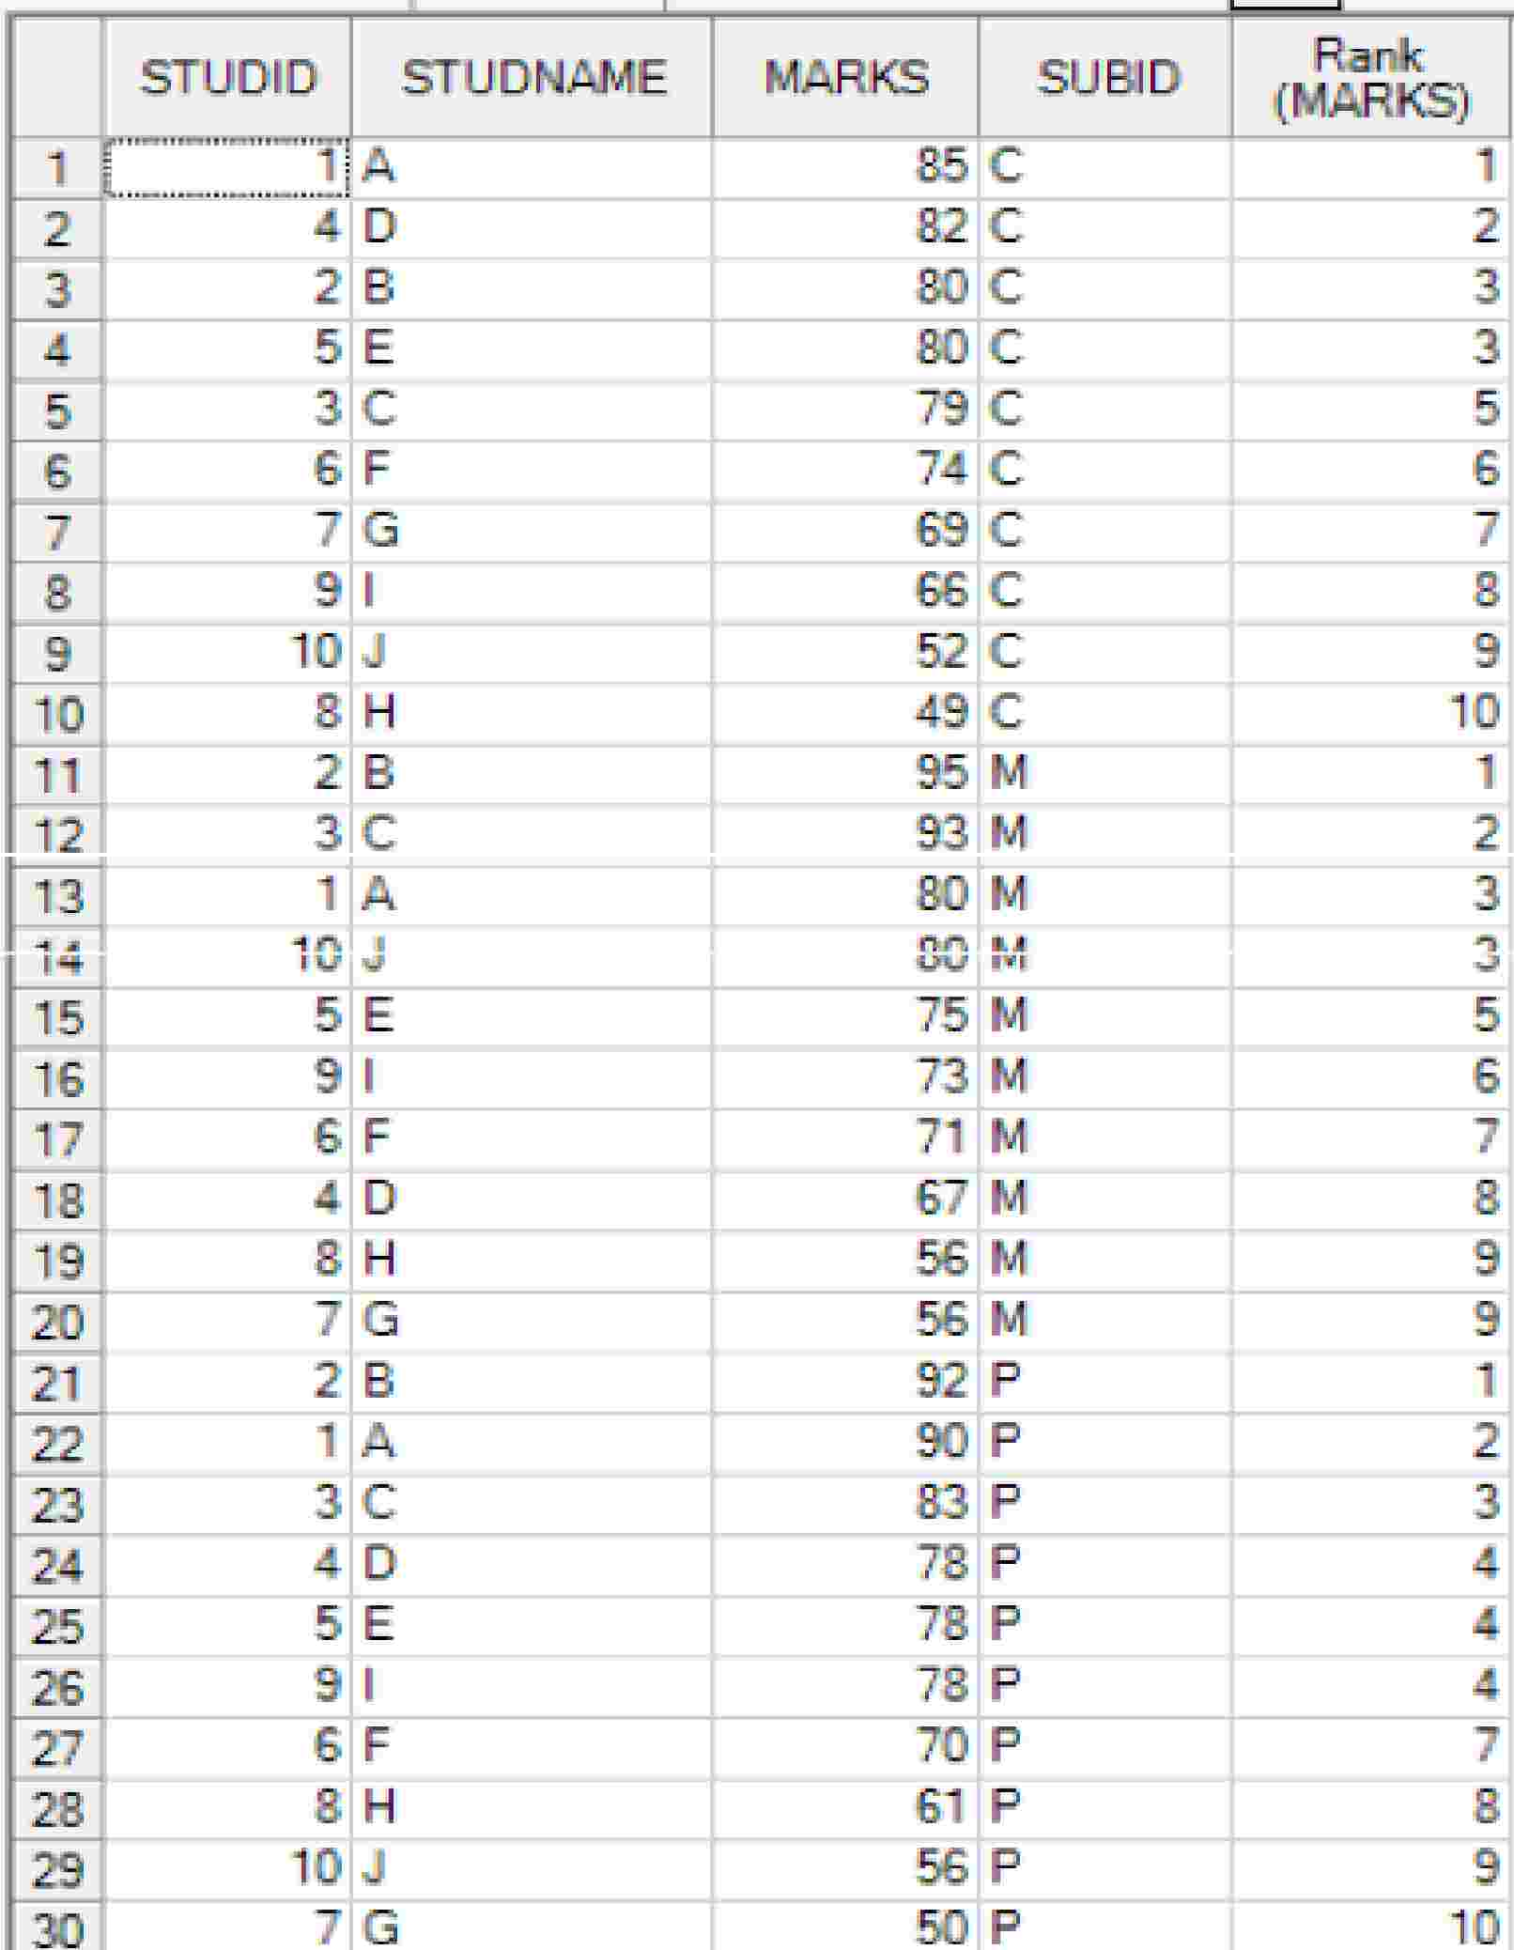

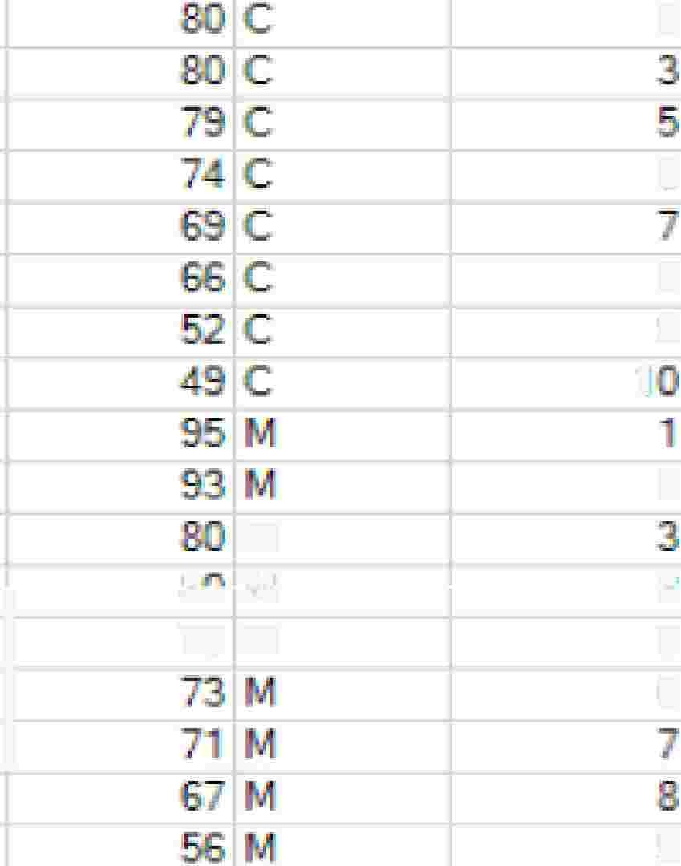


Usage of RANK & PARTITION BY
Ho
to ·; nd the
RA- -K of
each stude ton
eac
3
subjQct ase on thai
ob i a.� ed air ks...
6
8
,^{'9}
2
n,
M
I
I.Ji
1
..J
5
16
U'U ... ,
7.5 M
TD_8l1
'9

Slide 10
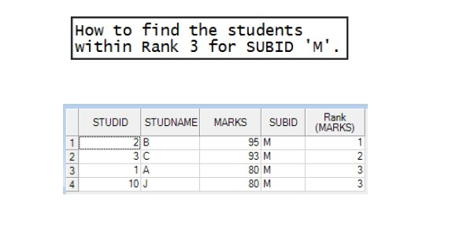
Usage of RANK, QUALIFY & PARTITION BY

Slide 11
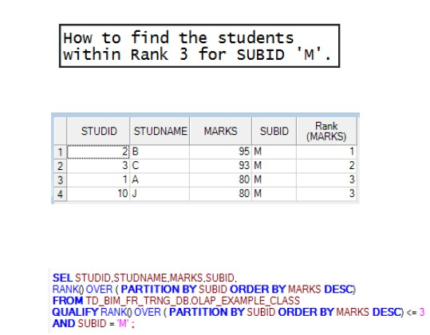
Usage of RANK, QUALIFY & PARTITION BY

Slide 12
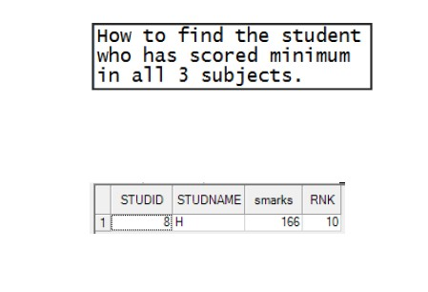
Usage of RANK, QUALIFY & PARTITION BY

Slide 13
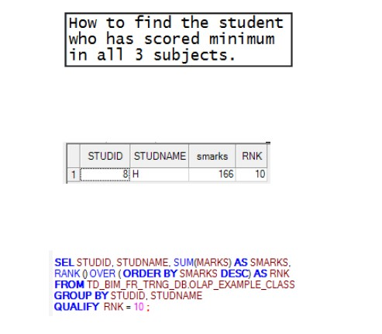
Usage of RANK, QUALIFY & PARTITION BY

Slide 14
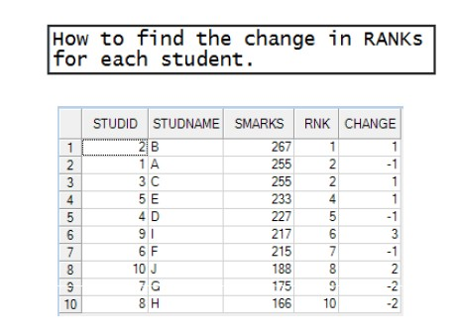
Usage of RANK, QUALIFY & PARTITION BY

Slide 15
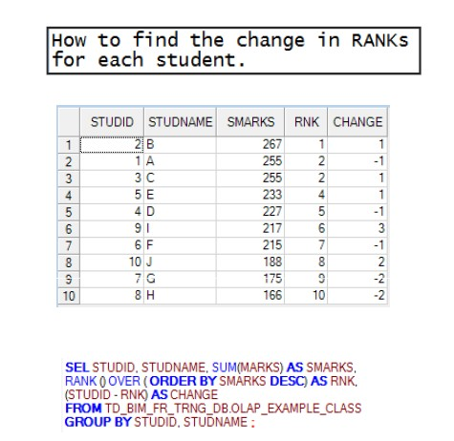
Usage of RANK, QUALIFY & PARTITION BY

Slide 16
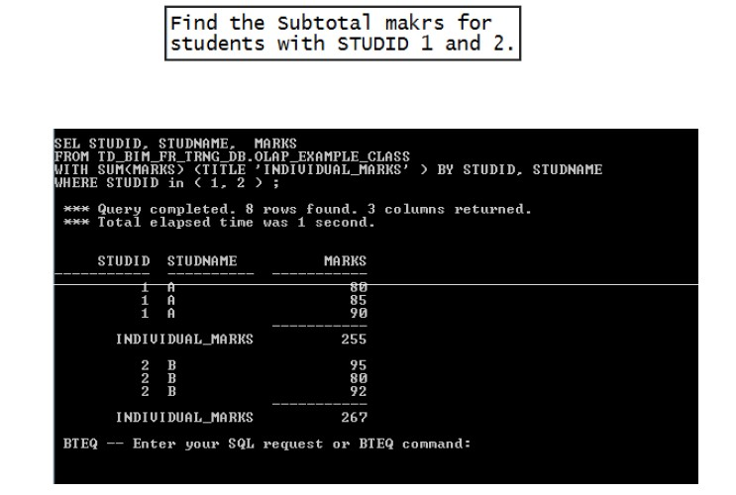
Usage of RANK & PARTITION BY

Slide 17






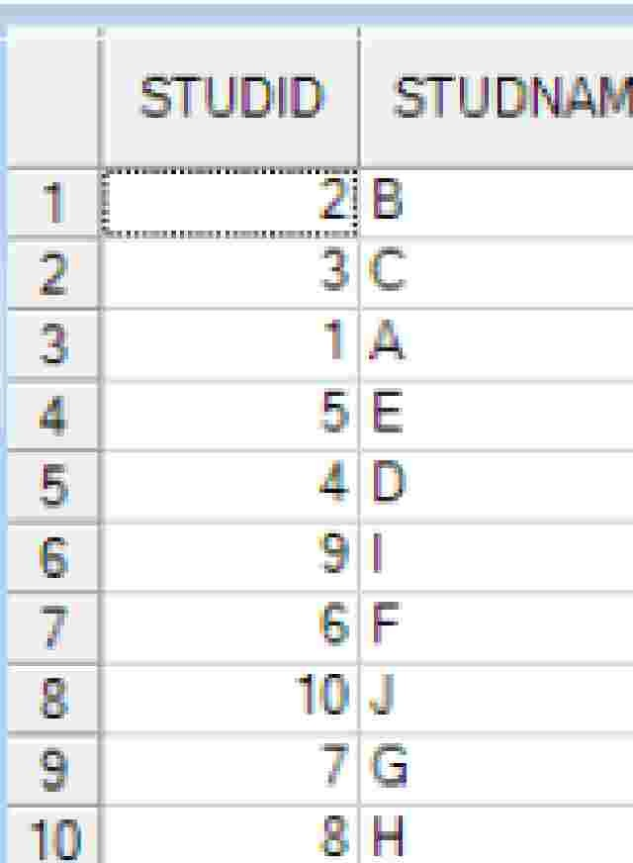
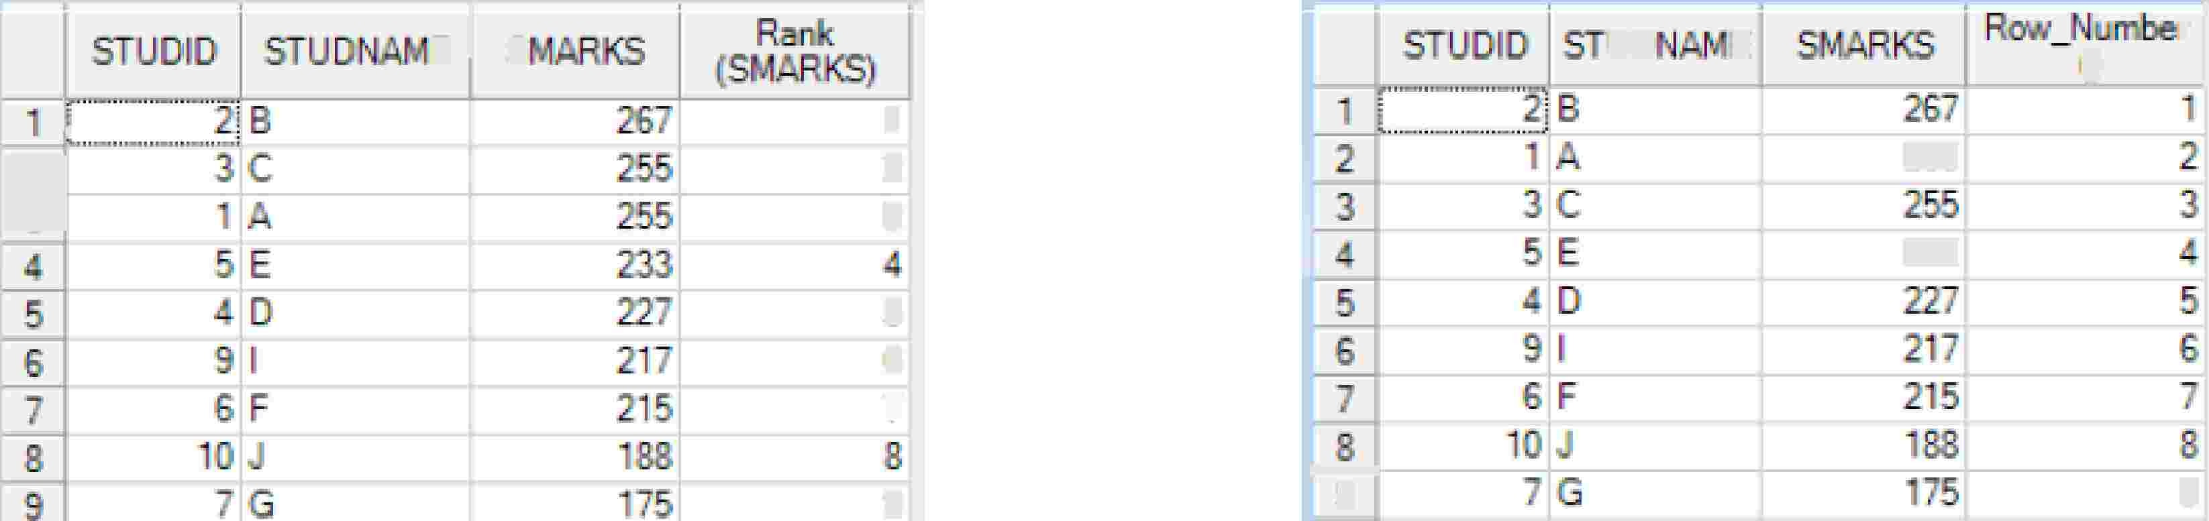
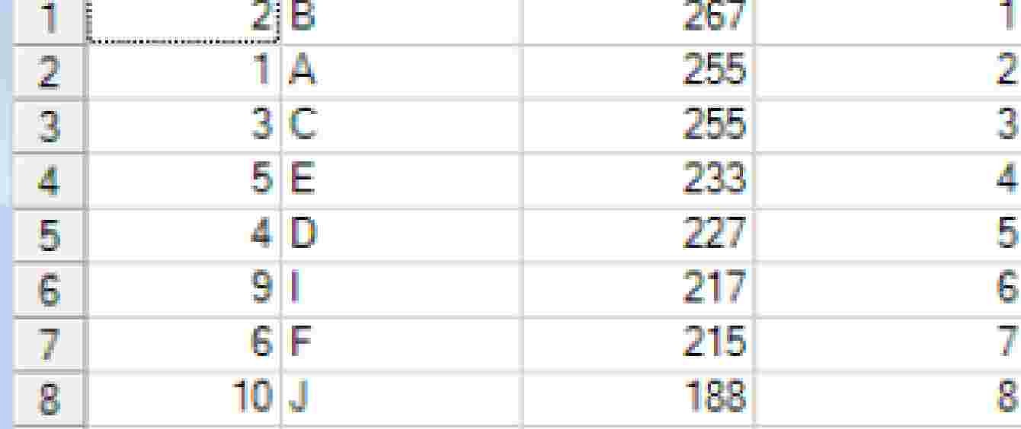
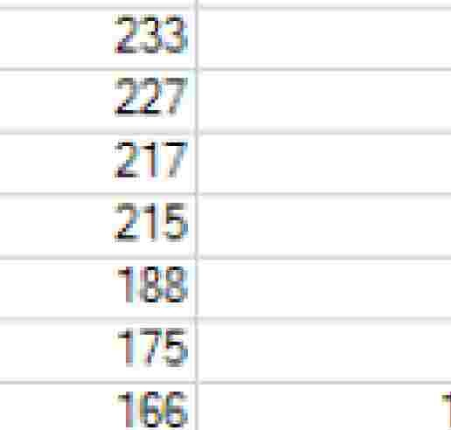
Usage of RANK & PARTITION BY
_c
5
Ej
s
uo-
- -
E
0
r I
I=
1
2
.2
255
�
233
5
6
7
1------t
s
9
'9

Slide 18
Q&A
1. Which two partitioning expressions are available to both single-
level and multi-level partitioned tables? (Choose two.)
A. MODULO_N partitioning
B. CASE_N partitioning
C. RANGE_N partitioning
D. Direct partitioning on a numeric column
2. What are two reasons a customer would choose table
partitioning? (Choose two.)
A. to improve performance of full table scans
B. to reduce the I/O for range constrained queries
C. for better distribution of data between the AMPs
D. for the ability to archive specific partitions in a table

Slide 19
Q&A
3. On which two table types can a multi-level partitioned primary index (MLPPI) be created? (Choose two.)
A. Volatile tables
B. Derived tables
C. Global temporary tables
D. Compressed join indexes
4. Which two table types support multi-level partitioned
primary indexes (MLPPI)? (Choose two.)
A. Base tables
B. Compressed Join Indexes
C. Global temporary Trace tables
D. Non-compressed join indexes

